Slide 1



Why
The Rotary Foundation?

Slide 2


Slide 3


Slide 4
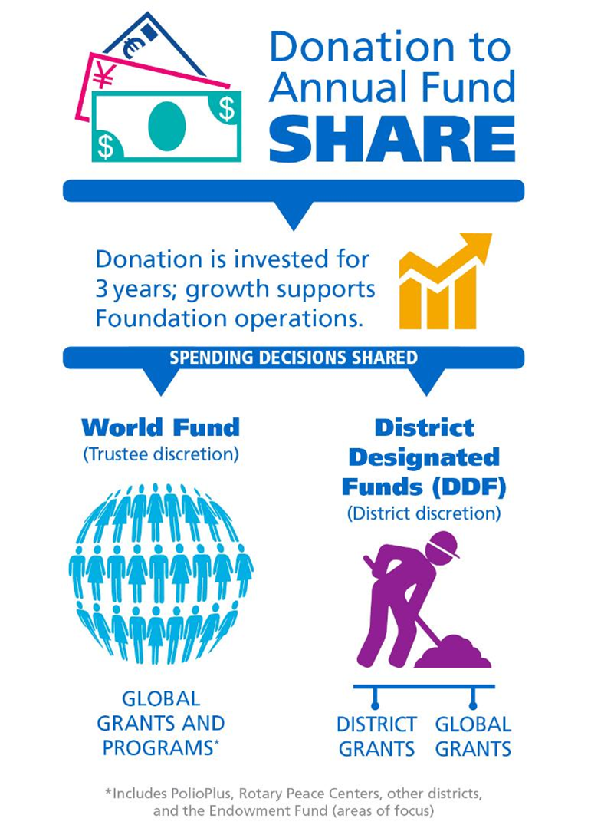




Annual Fund-
SHARE

Slide 5

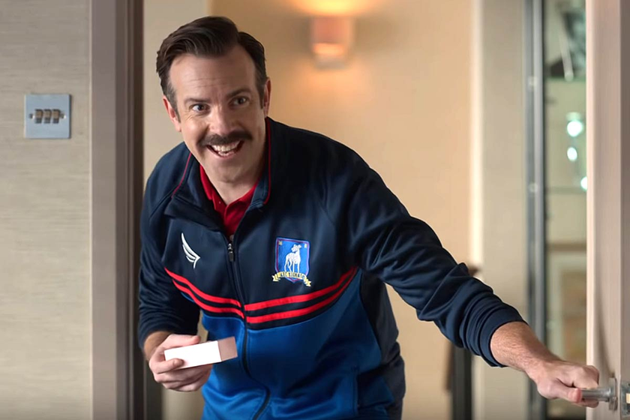

curiosity

Slide 6
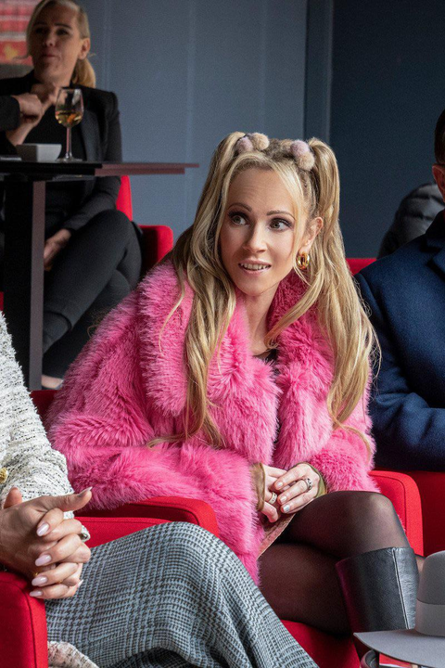

creativity

Slide 7


building
Connections

Slide 8
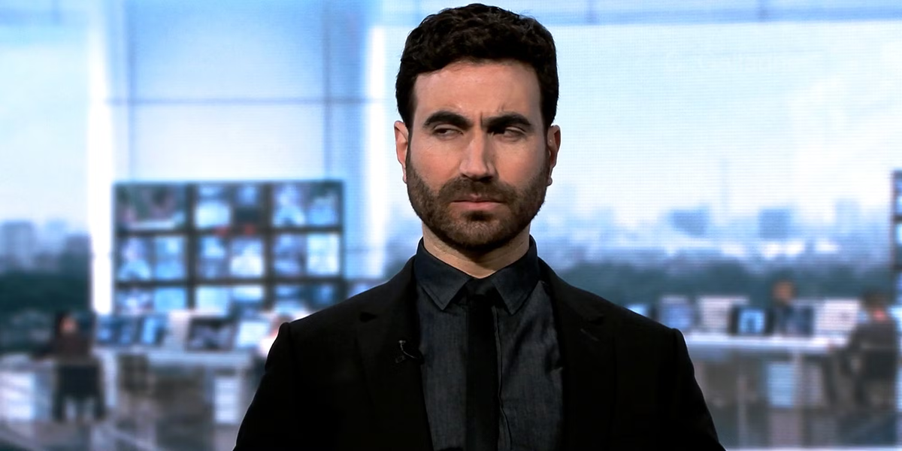
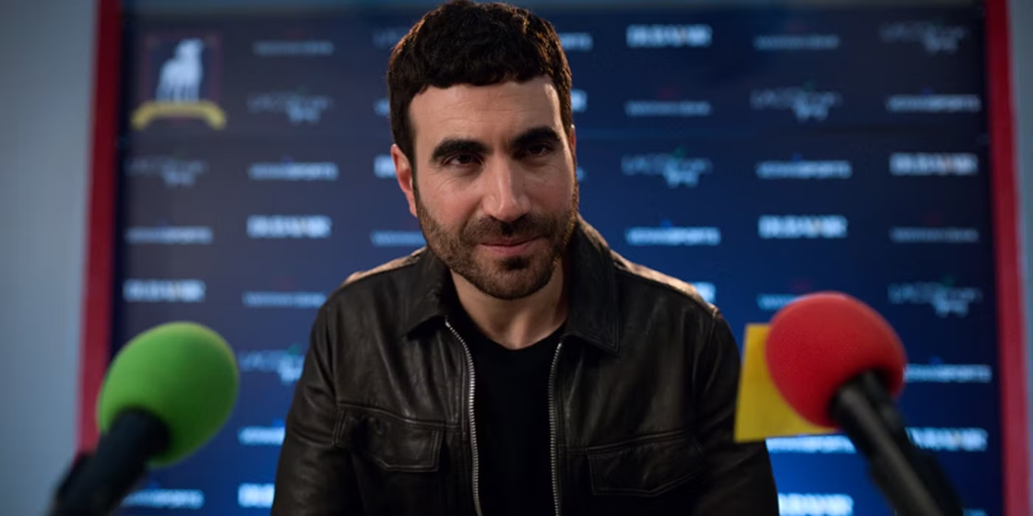
credibility

Slide 9


confidence

Slide 11


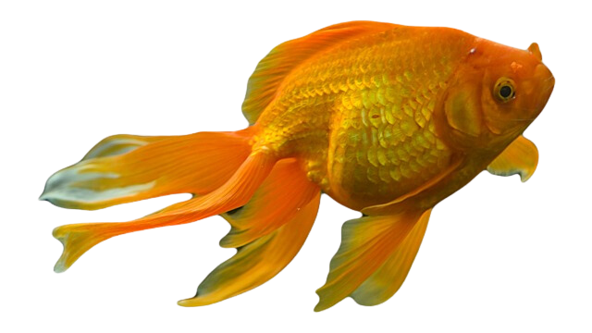


Slide 12
What motivates you to give to The Rotary Foundation?
What motivates you to give to other foundations or nonprofits?
What stories of impact do you have in your club?
What makes giving to The Rotary Foundation different from other causes?

