Slide 1
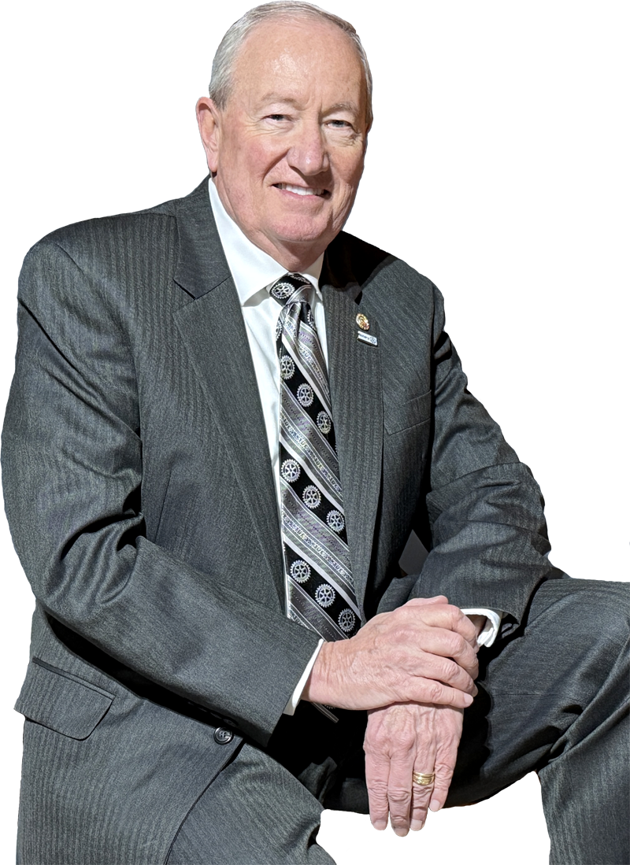
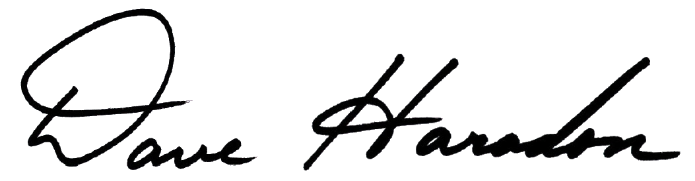
Community Needs Assessment
Longwood Rotary Club
Past District 7450 Governor
Cell: 484-883-3110
daveharadon@gmail.com

Slide 2

Community Needs Assessment (CNA)

Slide 3

Community Needs Assessments
What is a CNA?
Understanding Our Community’s
Strengths and Challenges.
Opportunities For Service Projects.
Best Way To Strengthen Our Clubs !!!
Prevents Duplication Or Redundant Community Efforts.
Gather Different Views On “What’s Possible”?
Kick Starts Your Club to Create Something NEW !!!

Slide 4

Community Needs Assessments
Community Assessment Tools
Surveys
- written, conversations, online
Asset Inventory
- walk and sit around, observe what’s valuable
Community Mapping
- draw a map, ask how often places are visited

Slide 5

Community Needs Assessments
Community Assessment Tools
Daily Activities Schedule
- work and visitation habits of residents
and local employees
Community Café
- ask people the general perception of their community.
Invited or random….
Focus Group – Planned Conversation

Slide 6

Community Needs Assessments
Community Leadership Focus Group
Purpose
Bring Community Leaders and Active
“Stakeholders” to Share Their Views
About the Community.
1. It’s A CONVERSATION.
2. Requires Careful PLANNING.
3. Requires Purposeful & Precise LISTENING Skills.

Slide 7

Community Needs Assessments
Community Leadership Focus Group
Opportunity
1. Positions Rotary As THE Community Leader
2. Bring Leaders (and Egos!) Together
3. Allows Exchange Of Varying Views
4. Begins Community “Alignment”
Among Fellow Community Leaders
5. Provides “Access” To MANY Potential Service Projects

Slide 8
Community Needs Assessments
Community Leadership Focus Group
NEW
NEW
NEW
IDEAS
ACTIONS
RESULTS

Slide 9
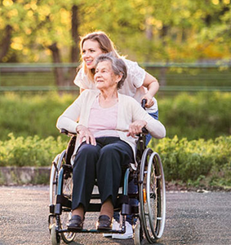

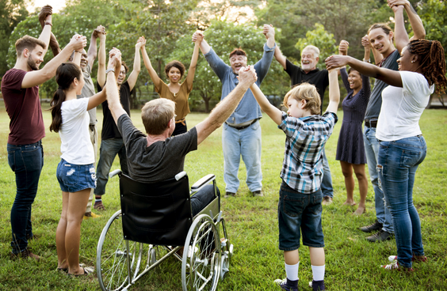
Community Needs Assessments

Slide 10






Community Needs Assessments
Community Leadership Focus Group
Rotary Club Opportunity
Gains Awareness of Club in the Community
Provides Membership Growth “Opportunity”
Fulfills our “Service Above Self” Mission.
Positions Club as THE Public Community Leader

Slide 11
Community Needs Assessments
CNA Meeting Preparation
Invitees
Meeting Size
Advance Planning
Location Preparation
Conversation Outline
Meeting Follow-up

Slide 12
Community Needs Assessments
Potential Participants
Local Community
Mayor
Town Manager
Town Council Members
Neighbor Community(s)
Mayor
Town Manager
Town Council Members
County
Commissioners
Town Manager
Town Council Members
Community Services
Police Chief(s)
Fire/ Ambulance Chief(s)
Hospital Executive

Slide 13
Community Needs Assessments
Potential Participants
Civic Leaders
Chamber of Commerce
Downtown Development
Other Service Clubs
Lions Club
Kiwanis Club
Optimist Club
Exchange Club
Non-Profit Organizations
YMCA
Food Cupboard
League of Women Voters
Senior Centers
Mothers Support
Family Counseling
Economic Development
Boy & Girl Scouts
Other Community Orgs
Churches
Veterans of Foreign Wars
Rotary Club Member
Club President
Club President-Elect
Club Vice-President
Board Members
Service Committee Chair
Secretary (Scribe)

Slide 14


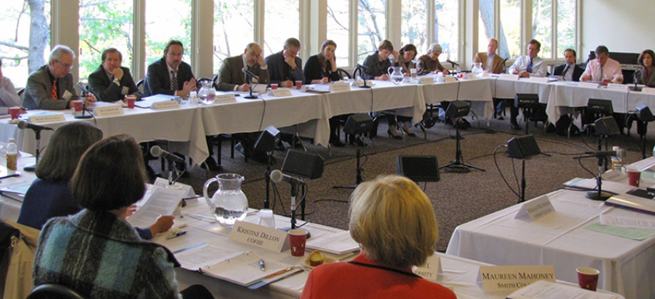
Community Needs Assessments
Group Size Matters
Medium Groups
20-30 people
(Best !!!)
One-on-One
Small Groups 3-10 people

Slide 15

Community Needs Assessments
Group Size Matters
Greater than 50-75
CHALLENGING !
Lacks Interaction
Too “Corporate”
.
Invite 1.5-2X
Desired Attendance

Slide 16

Community Needs Assessments
Planning The Meeting
Select date and time.
LOTS of advance notice !
Start with a US Mail invite
Follow-up with email reminders
Conduct an enrollment phone conversation.
This is crucial….
PRACTICE first with each other.

Slide 17






Invitation Design – April 2025
Rotary Logo & Event Title
Personalized; Mail Merge
Online RSVP; Eventbrite event system (free);
Short bitly.com URL; Customized name URL
Signed by Club President
(Use Sharpie, then convert to image)
QR Code for RSVP (Rotary Blue); Source: bitly.com

Slide 18


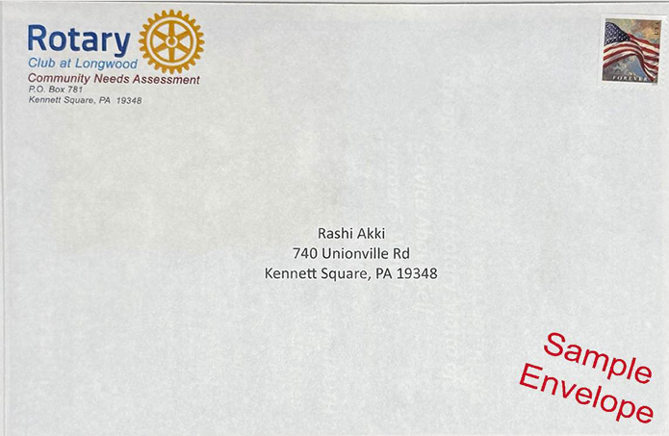
Invitation Design – April 2025
Front
Back
Envelope
Letter

Slide 19

Invitation Design – April 2025
Regular Postage
(i.e., not extra)
“Booklet” Fold Closure”
6” x 9” “Invitation” Envelope
Content Size
5-5/8” x 8-7/8”

Slide 20
Community Needs Assessments
Phone Call Invitation
Conversation – PRACTICE !
Tell them who you are…
Check to assure they can talk at that moment.
Tell them WHY you are calling?
Invite them to a FREE “breakfast conversation”
Topic: “About helping our community to become a
better place to live, work, play and shop.”
“Invite you to consider the possibility of attending”?

Slide 21

Community Needs Assessments
Meeting Setup
Semi-Circle Seating
Nice facility
- Large, private & professional
- Quiet/room for eating and talking
Not crowded
Semi-circle or Half-round table seating
- “Soft rounded” is comfortable
- NOT a square U
Everyone needs to easily see each other
for interactive conversation

Slide 22


Community Needs Assessments
Meeting Setup
Special Directions Signs at Entrance Facility
- Branded With Rotary Logo &
“Community Needs Assessment”
3M Sticky Blank Chart Pads (hang on the walls)
Two Or Three Sturdy Chart Pads Easels
Multiple Color & Thick Markers

Slide 23
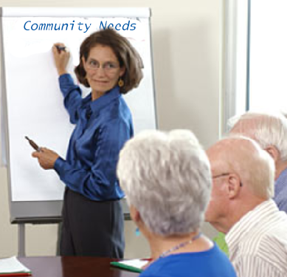
Community Needs Assessments
Meeting Setup
1 Facilitator,1-2 Scribes. No PowerPoint !
Good Large-Type Printed Handwriting(Not Cursive)
No Podium
Facilitator - Professional or Good Amateur
- Listens Precisely and Patiently
- Engages Others
- Positive And Enthusiastic Demeanor
Scribes - Use The Exact Words Articulated !!!
- Legible
- PRACTICE, PRACTICE, PRACTICE

Slide 24
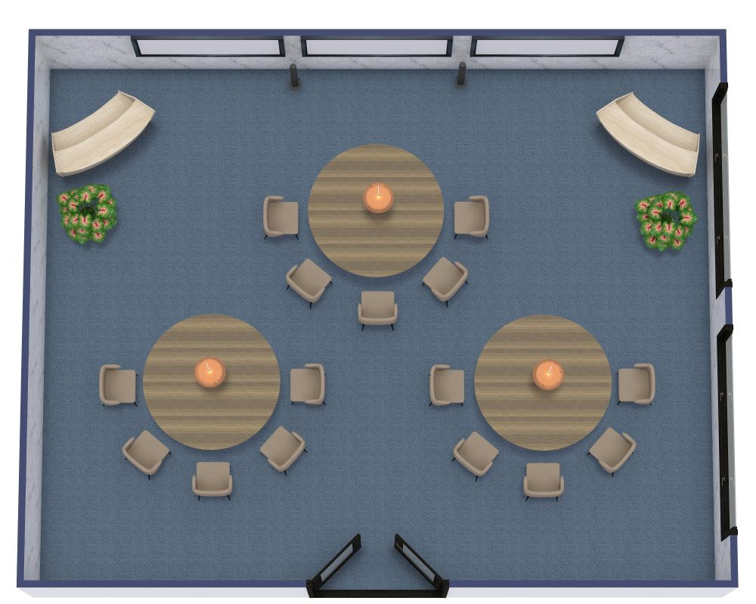
Community Needs Assessments
Day of Meeting
Setup Room Well In Advance
Have A Welcoming Host at the Door
- Standing (Not Sitting)
Pre-event Cocktails - Wine/Beer
(Loosens The Tongue, Frees The Mind)
Rotary Members Engage the Guests in
pre-Meeting Conversation – LISTEN !

Slide 25
Community Needs Assessments
Day of Meeting
Food: Simple Sandwiches Or Light Buffet
- Elegant and Polite. NOT a LOT of Food
Printed Agenda and Names/Titles of Attendees
Begin Meeting
- Get Your Food
- Sit Down
- Let’s Begin…
- This is a Working Meeting

Slide 26

Community Needs Assessments
Summary Review
Guest List
Location – Classy
Food – Snacks – Keep it Light
LOTS of Advance Notice
Personal Phone Calls
Follow-up emails AND Snail Mails
Skilled Facilitator & Scribe
Wine and/or Beer

Slide 27

Community Needs Assessments
Group Conversation Questions
Describe our community…
How is our community doing on a scale of 1-10?
What’s working well in our community?
What’s not working in our community?
What’s missing in our community?

Slide 28
Community Needs Assessments
Group Conversation Questions (continued)
What’s a PERFECT 10 community look like?
What’s really important to you and to our community, our citizens and our neighbors?
What opportunities exist for Rotary
to create something new and
EXTRAORDINARY in our community
(money, labor, talent, service, manpower,
organization, LEADERSHIP !)

Slide 29
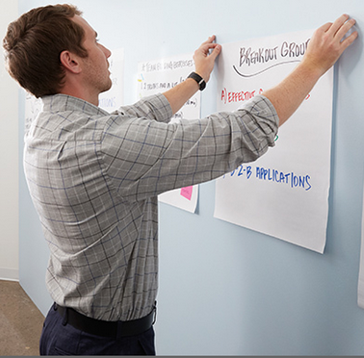
Community Needs Assessments
Meeting Techniques
Capture everything on chart paper
Hang them on the wall for all to see
(Group Memory)
Do NOT look for or try to describe solutions.
That comes LATER after this CNA meeting!
Gather ideas and look for Future Possibilities…
Avoid “Past Based” dialogue…
Create “FUTURE Based” Conversations !

Slide 30

Community Needs Assessments
Meeting Conclusion…
GREAT Meeting !
Restate and summarize what you heard.
Path forward –
“We will absorb this and come back to
you with some ideas and possibilities
that we can all work on and create together.”
“THANK YOU for joining us tonight !!!”

Slide 31


Community Needs Assessments
LISTEN – LISTEN – LISTEN
It’s not about YOU !
If you’re talking about you,
you’re not listening to them… !
IT’S REALLY ABOUT
“SERVICE ABOVE SELF”

Slide 32
Community Needs Assessments
After The Meeting
“Thank You” Phone Call Follow-up
Send handwritten “Thank You” Note.
- Include small Rotary gift.
Establish a future date for getting back together.
Invite to a Rotary Meeting – POTENTIAL MEMBER !
Stay in touch with these people !!!

Slide 33

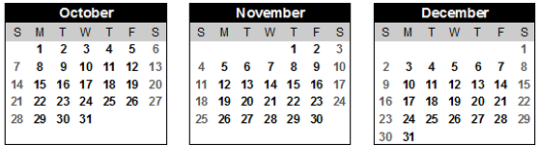
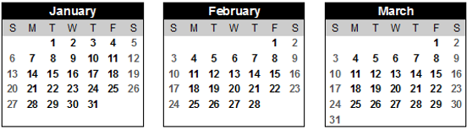
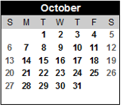
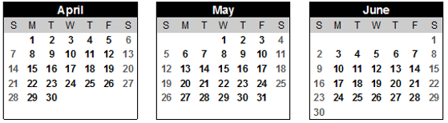
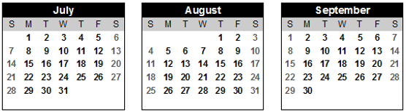
CNA Case Study
Case Study:
2019

Slide 34
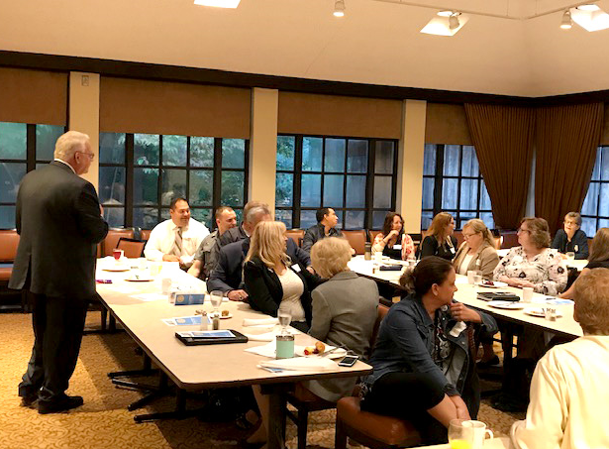
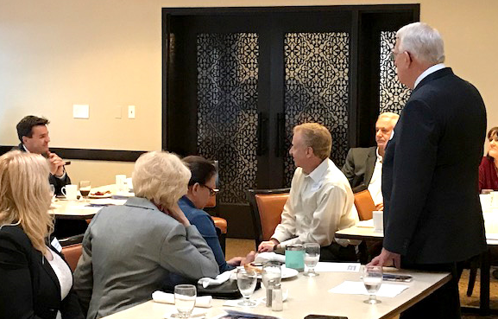
CNA Case
CNA Meeting
36 Community Leaders

Slide 35

CNA Meeting
36 Community Leaders
How is our Community: 1 10?
What’s Working?
What’s NOT Working ?
What’s MISSING?
What’s a perfect “10” look like ?
What ACTIONS are needed ?

Slide 36
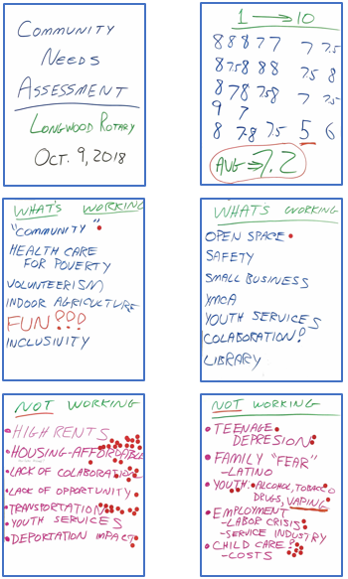
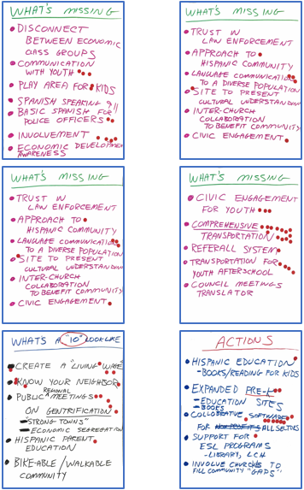
CNA Meeting

Slide 37
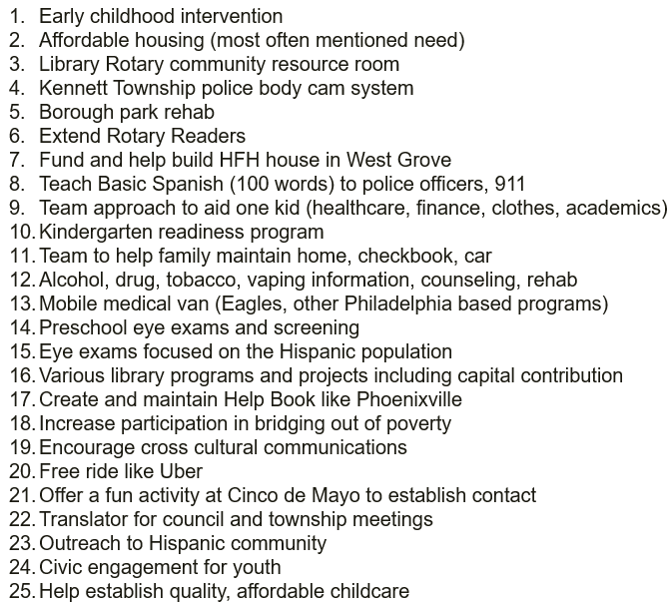
Analysis – 25 Potential Projects
Potential Projects – Longwood Rotary Club
Education
Housing
Transportation
Community Development
Job Training

Slide 38

#1 Education
Pre-K Education
Parenting Classes
Kindergarten Readiness
Adult Literacy
Support Maternal Health & Child Consortium’s Parenting Classes - $8,800 + Volunteers
.
Support Pre-K Need Based Scholarships - $27,000
- Tick Tock Early Learning Center
- First Presbyterian Church
- Ducklings Early Learning Center
- Kennett Square Pre-School Cooperative

Slide 39
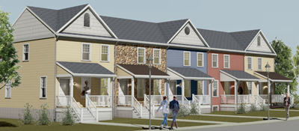
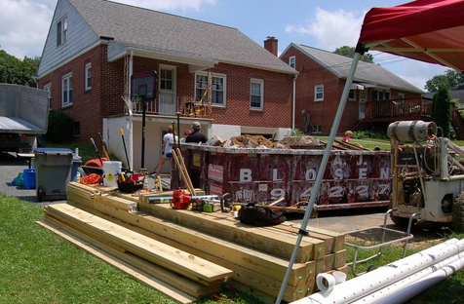
#2 Housing
Need additional “Workforce Housing”
Sustainable Housing Repairs
Partner with Habitat for Humanity
- $50,000 + Volunteers
to construct 40 homes
.
Partner with Good Neighbors
- $8,000 + Volunteers
for housing repairs

Slide 40
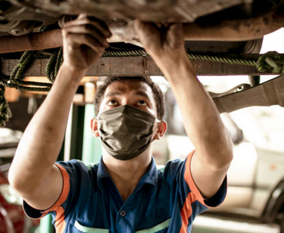
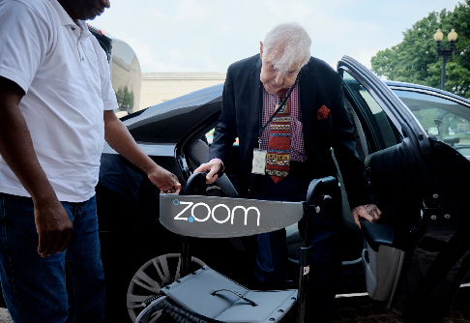
#3 Transportation
Reduce Transportation Costs
Increase Transportation Availability
Auto Repair – “Trusted Partner Network”
“Car Buyer Assistance” Program
Find “Great Value” cars inspected and validated
Seek low financing rates for car purchases
Short term / low-cost rental programs
Provide educational offerings for car
maintenance insurance and purchase
Develop volunteer driver program – Volunteer Driver Campaign

Slide 41

Next Steps To SUCCESS !!!
Assess the ongoing success of current initiatives.
Expand solutions in the three priority areas…
(Education – Transportation – Housing)
Re-visit the Community Needs Assessment (CNA) process for additional community impact ideas and opportunities. Meet again with leaders ~January 2020.
Expand our own volunteer labor commitments to support new and longer-term projects
- Habitat for Humanity
- Good Works,
- pre-School Education,
- other NEW Ventures, etc.

Slide 42
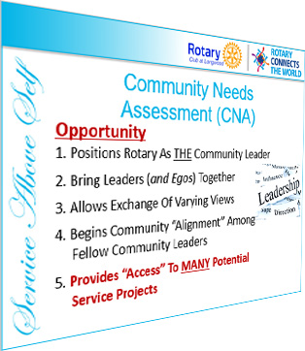

“Service Above Self”

Slide 43
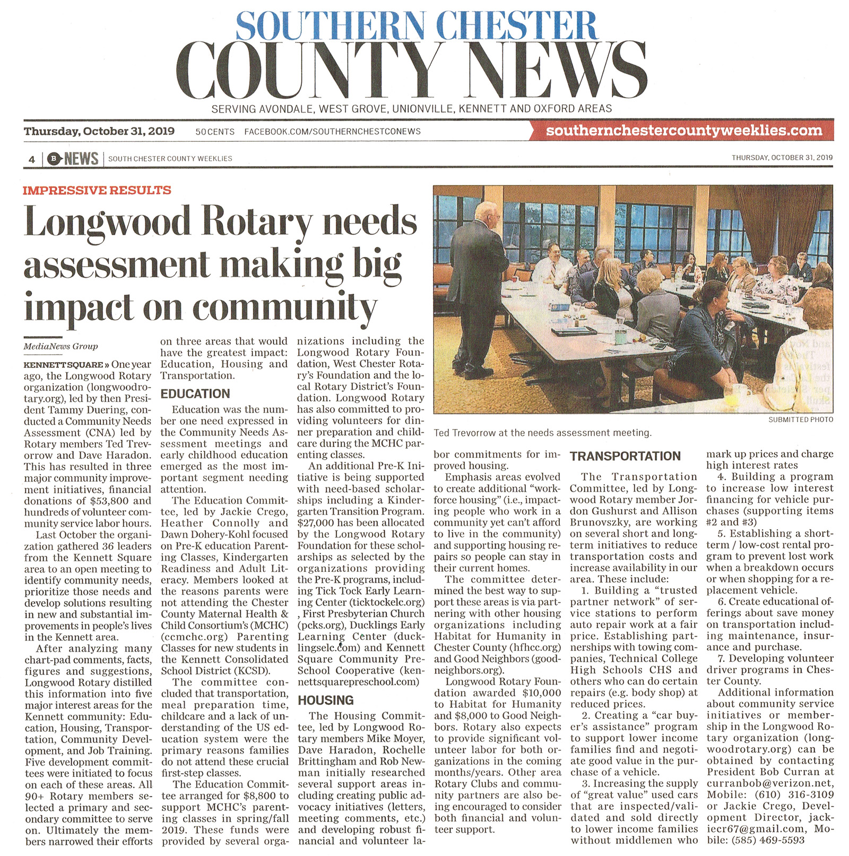
Public Image

Slide 44
When to Conduct a CNA?
DO IT NOW !!!
Build Excitement !!!
Plan & Prepare NOW
Execute in Spring: Before Mid-June
Sets Up the Next Rotary Year: 2025-2026

Slide 45
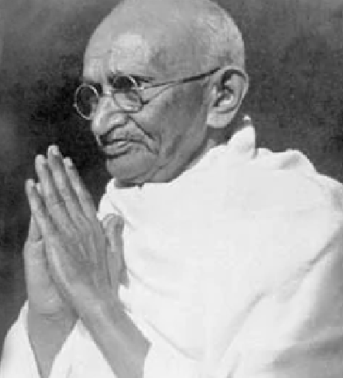
Quote of the Day…
If You Want to Find Your Self…
Get Lost in Service to Others !!!
- Mahatma Gandi

Slide 46
Questions ????????
Questions …?
Comments …?
Thoughts…?

Slide 47
THANKS !!!
Thanks for Listening !!!

