Slide 1

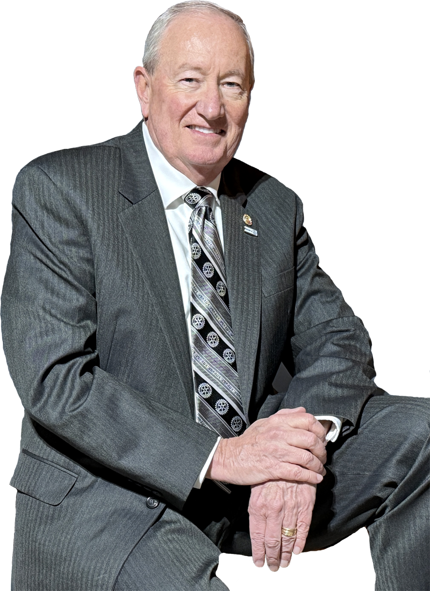
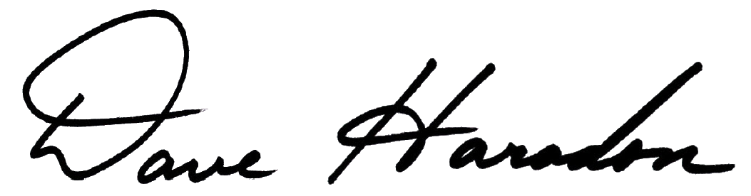
Welcome…
Rotary Club “Assessment”
`
Tools for Improvement
Dave Haradon
Longwood Rotary Club
Kennett Square, PA
Past District 7450 Governor (2016-17)
Cell: 484-883-3110
Email: daveharadon@gmail.com
BE EXTRAORDINARY

Slide 2


“Assessment”
Rotary Club “Assessment”?
Tools for Improvement
A comprehensive evaluation of an organization’s… processes structure culture
Used to identify… strengths weaknesses opportunities
Area of “Opportunity” to Make a Difference !

Slide 3

“Assessment”
Areas of Emphasis
Strategic Planning: Ensuring that the organization's goals and strategies are aligned with the Club’s Vision and Mission ..
Leadership and Management:
Evaluate the effectiveness of your Club’s leadership and management practices. .
Membership: Assessing your membership’s skills, engagement, involvement and satisfaction.

Slide 4
“Assessment”
Areas of Emphasis
Operations and Processes: Reviewing the efficiency and effectiveness of how your Club operates and work together.
.
Culture and Climate: Understanding the Club’s culture, member morale, and Club meeting location’s environment.
.
Financial Health: Analyze the finances of your Club including dues, fundraising efforts, expenses, monetary donations, endowments, etc.

Slide 5
“Assessment”
Areas of Emphasis
Technology Systems: Evaluate the use of technology to efficiently administer your Club, e.g., DACdb, Club Runner, website, etc.
.
Communications & Marketing:
Review how your Club communicates with members, District, Rotary Int’l, local community organizations and area leaders. How well you are utilizing both traditional newspapers and social media systems?
..

Slide 6
“Assessment”
Areas of Emphasis
Growth: Ascertain if your Club is surviving or thriving. Who is responsible for Club Growth (Answer: EVERYONE). Assess Club members commitment to GROWTH for both longevity, Community Impact and involvement.
.
Personal Development:
Address how active your Rotary education is delivered to members and the existence of vocational education
& leadership training is offered and welcomed.

Slide 7

The Rotary Railroad…
It’s Not Easy…
Top 10 Areas of Emphasis
Leading the Rotary Railroad
Time
Commitment
Patience
Energy
Knowledge
Fortitude
(and a LOT more !)
Strategic Planning
Leadership and Management
Membership
Operations and Processes
Culture and Climate
Financial Health
Technology Systems
Communications & Marketing
Growth
Personal Development

Slide 8

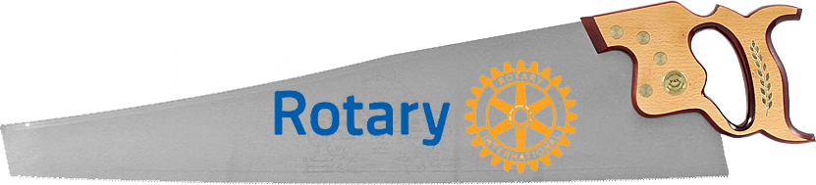



Rotary Tools…
Rotary Tools

Slide 9

Rotary Tools…
Rotary Tools

Slide 10
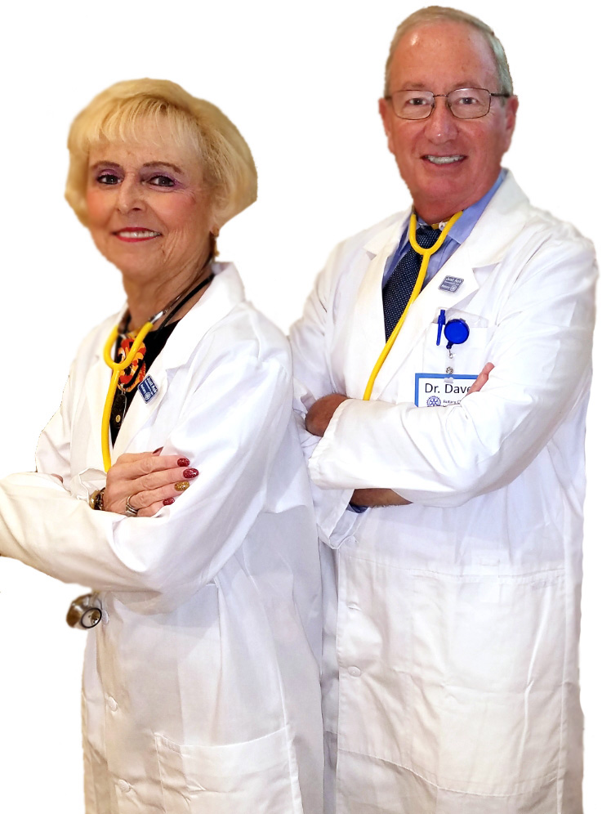
Rotary Tools…
Rotary Tools

Slide 11
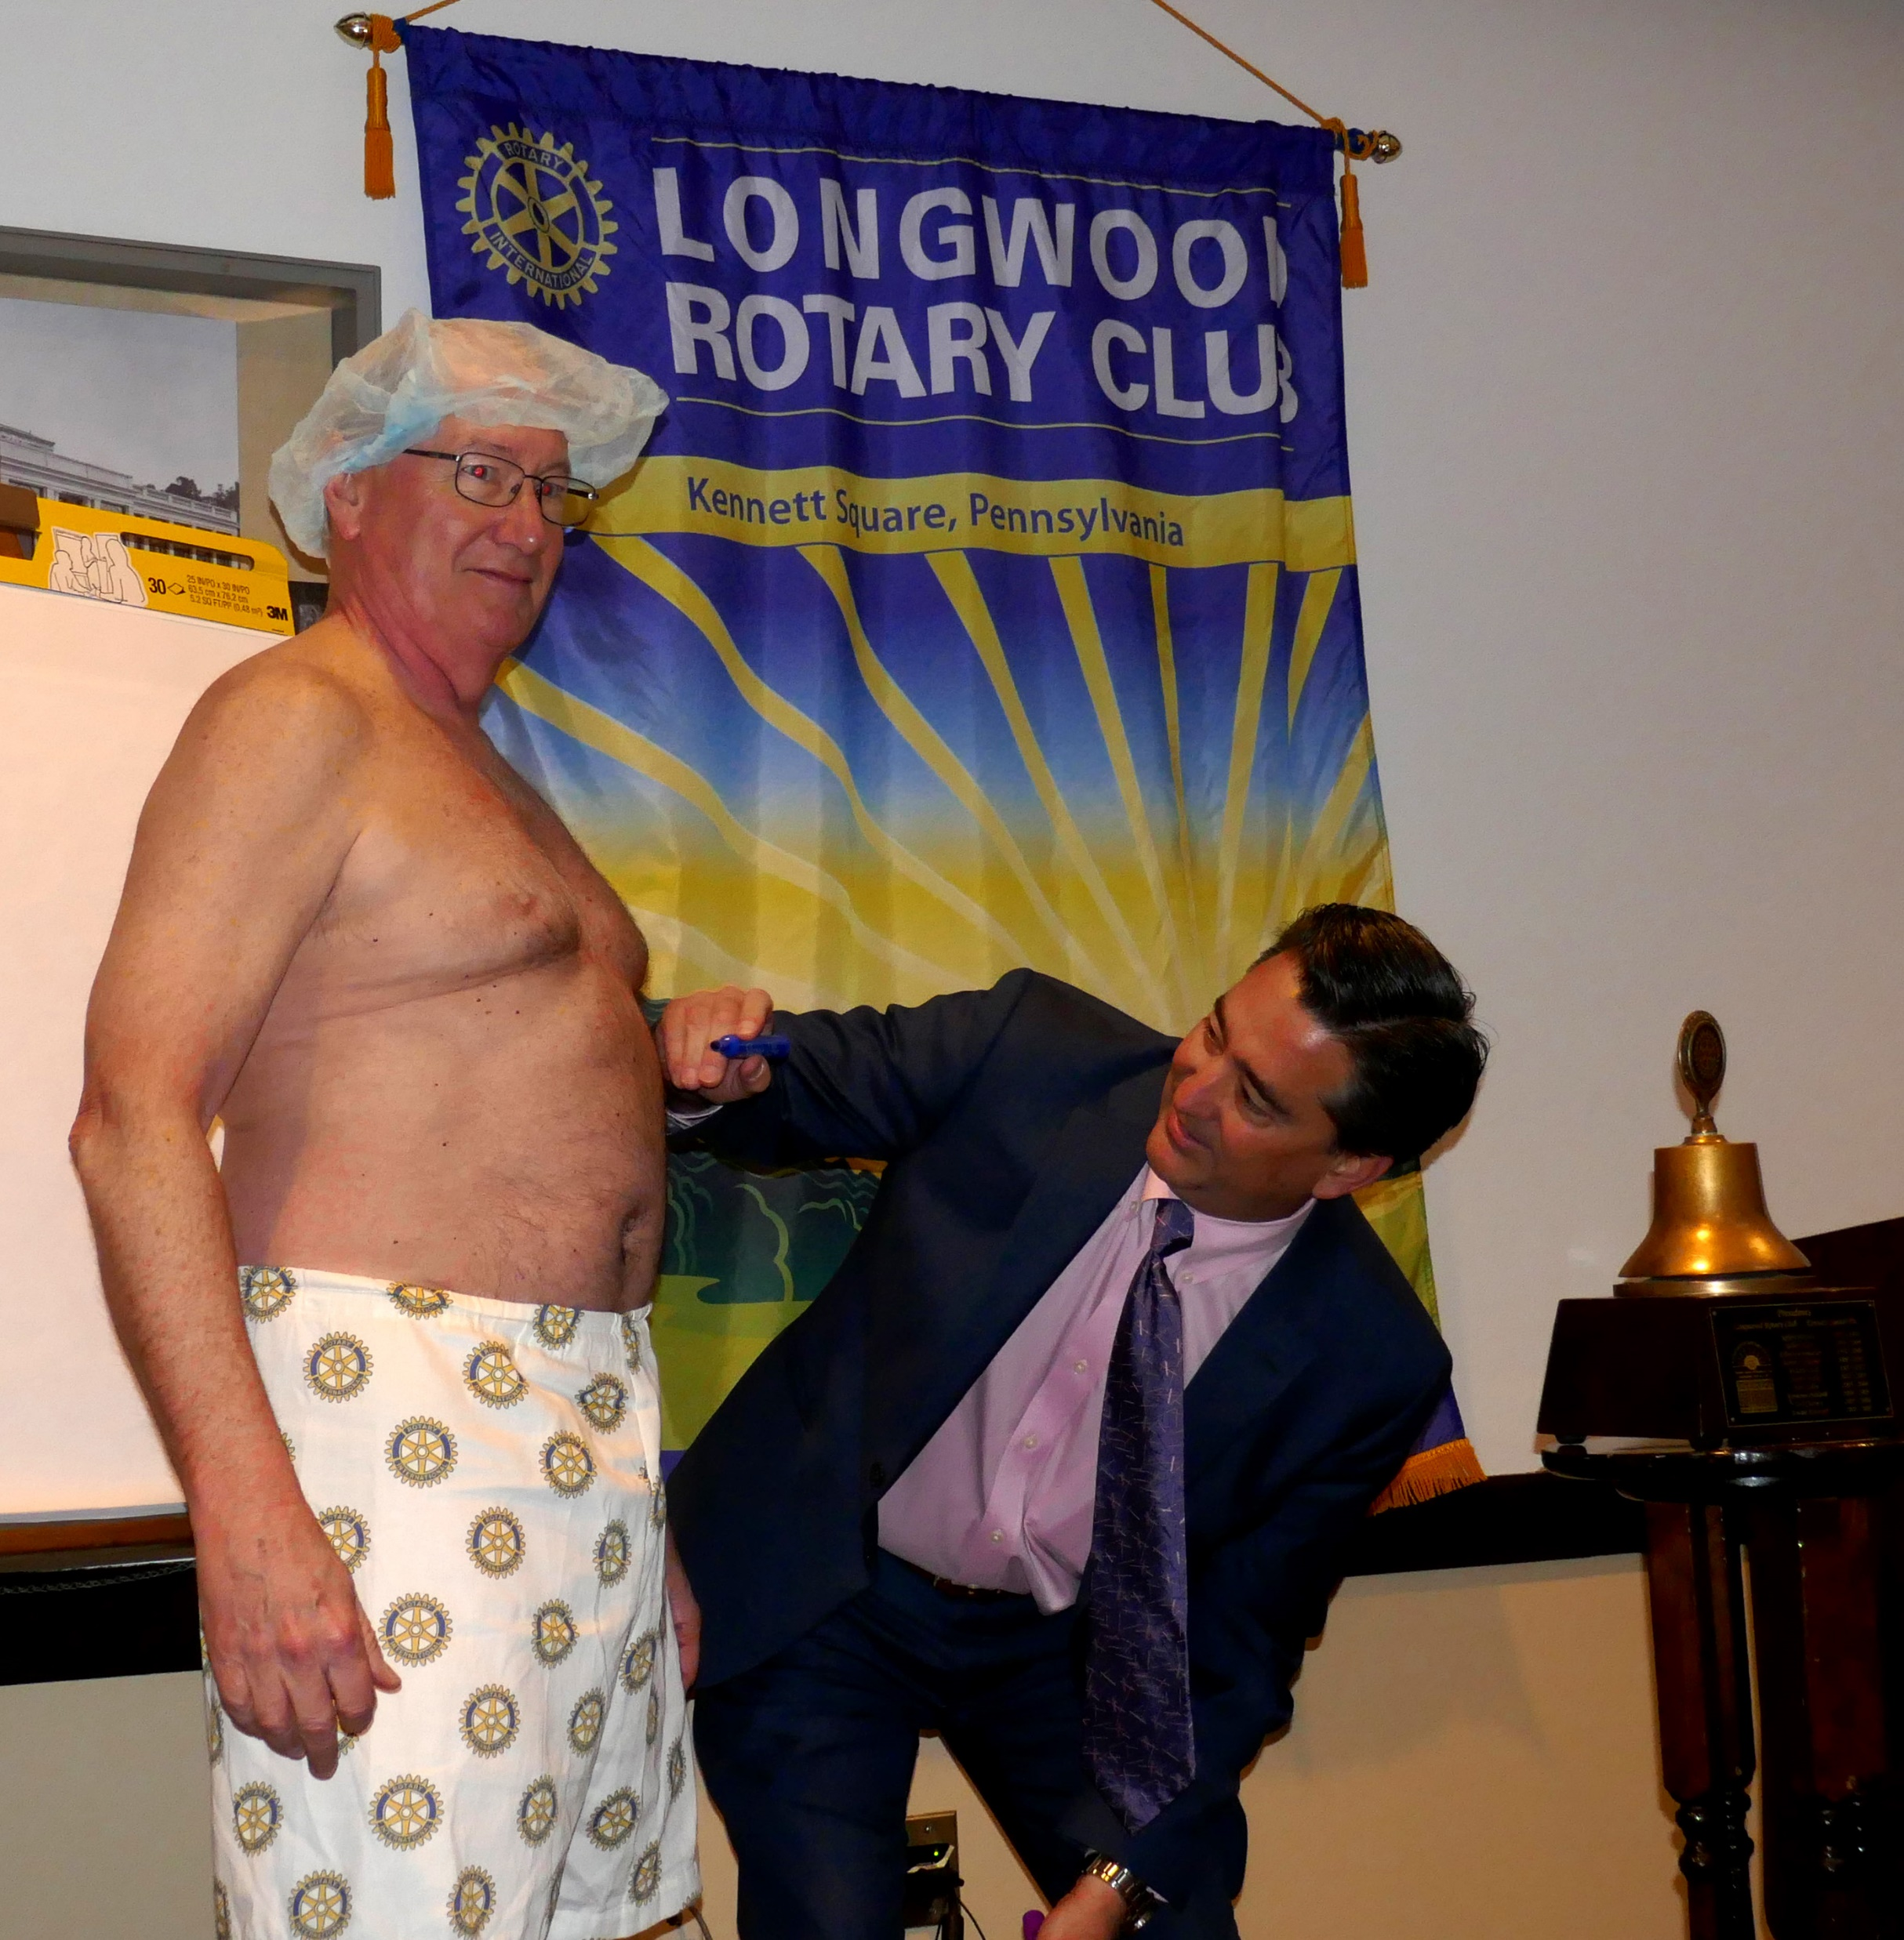
Rotary Tools…
Rotary Tools

Slide 12
Rotary Tools…
Rotary Tools
Health Check Questions
Club Experience 13 questions
Service & Socials 11 questions
Members 16 Questions
Public Image 12 questions
Business & Operations 14 questions
======== ========== TOTAL 66 questions

Slide 13

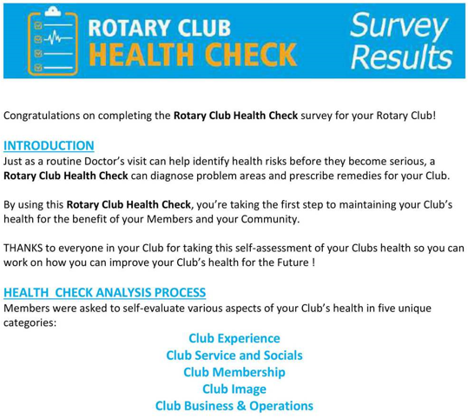

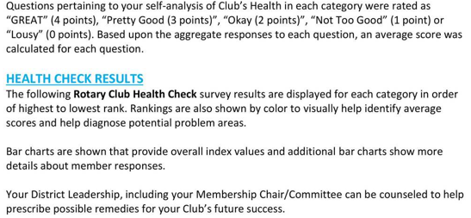
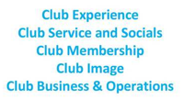

Slide 14
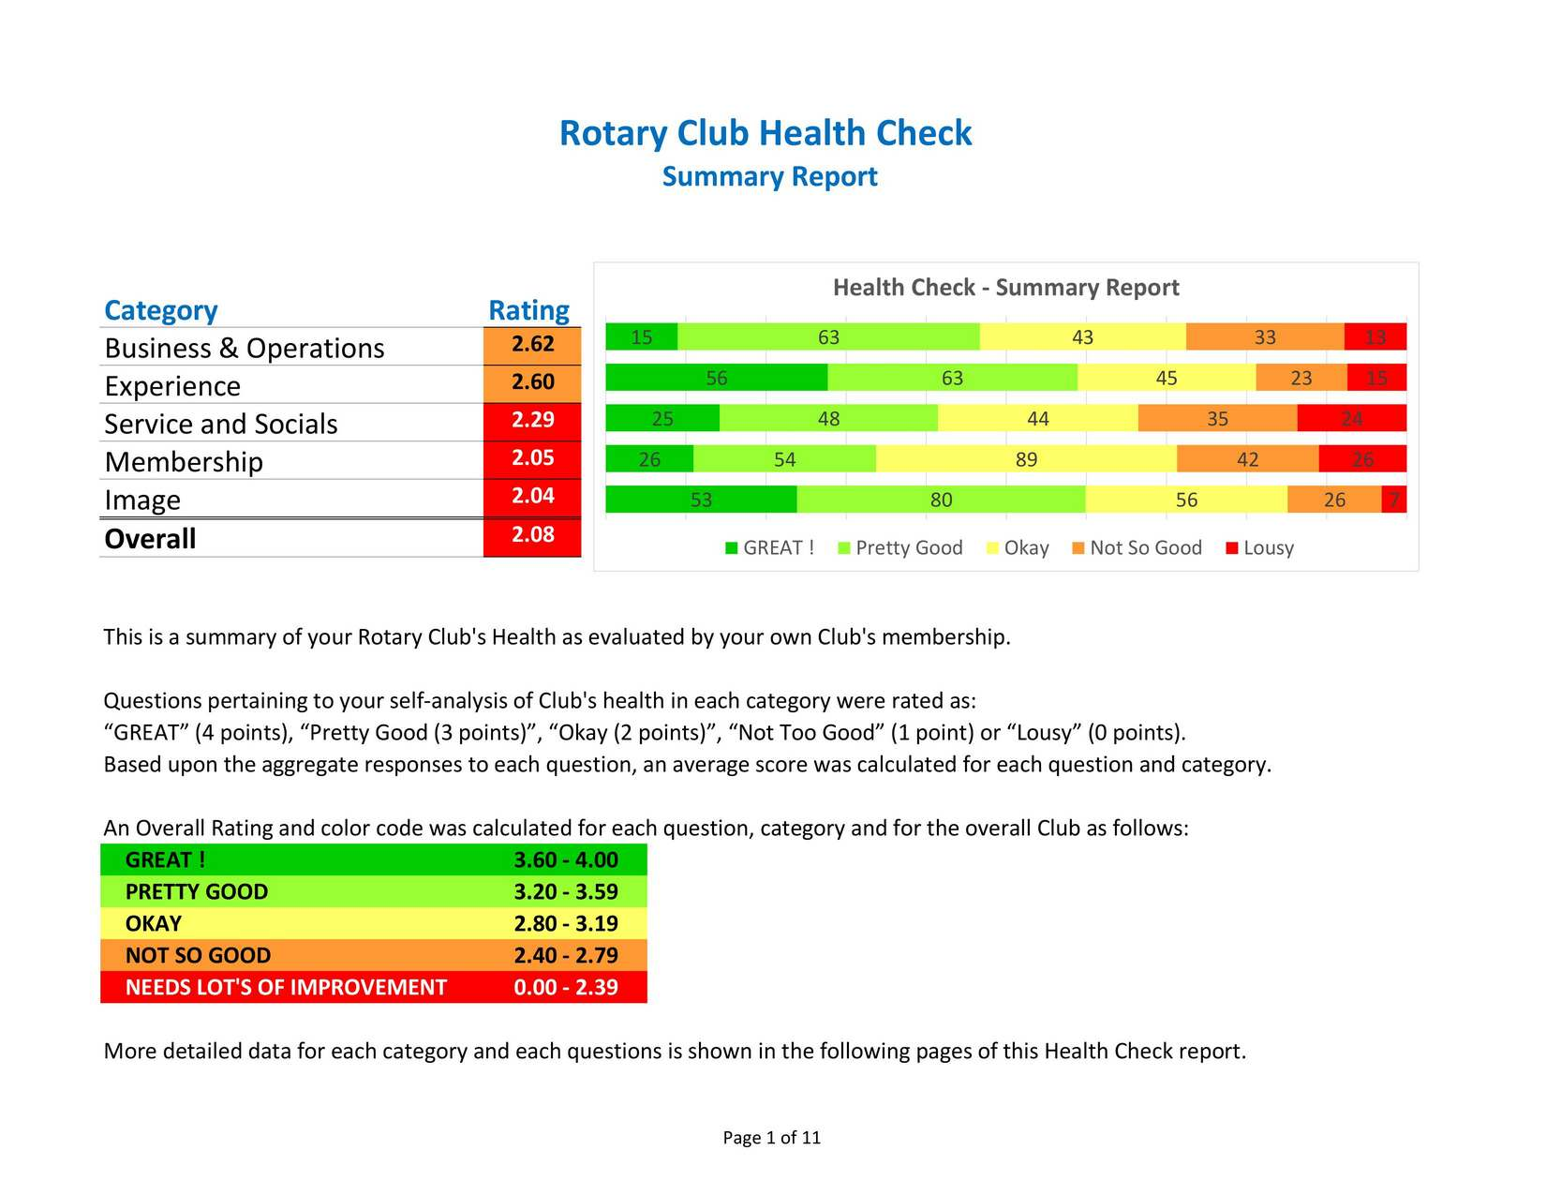

Slide 15
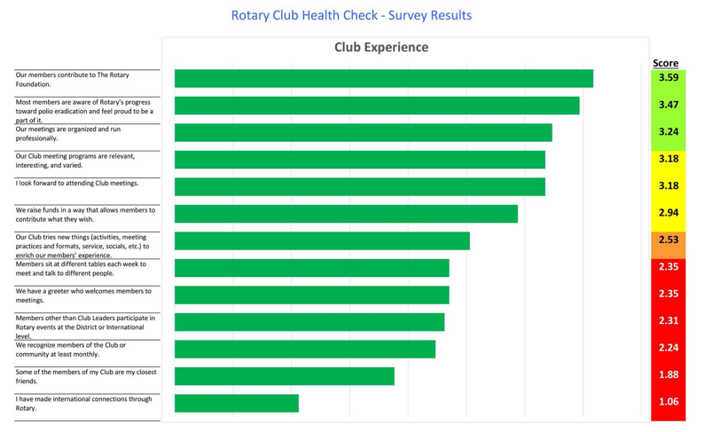

Slide 16
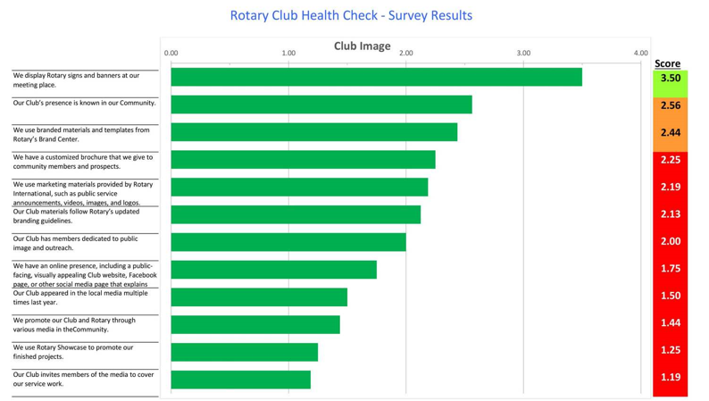
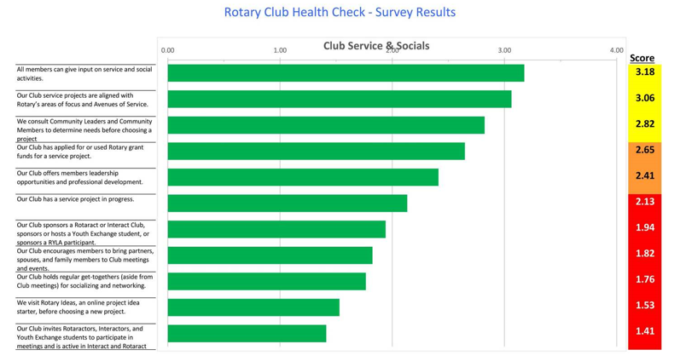
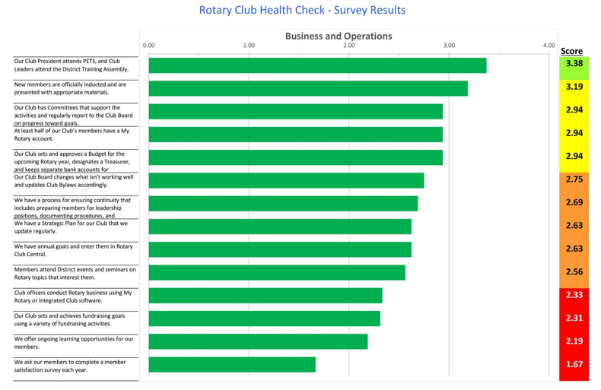
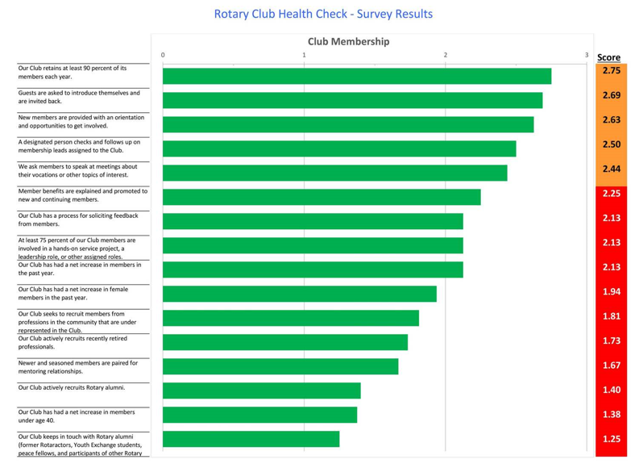

Slide 17
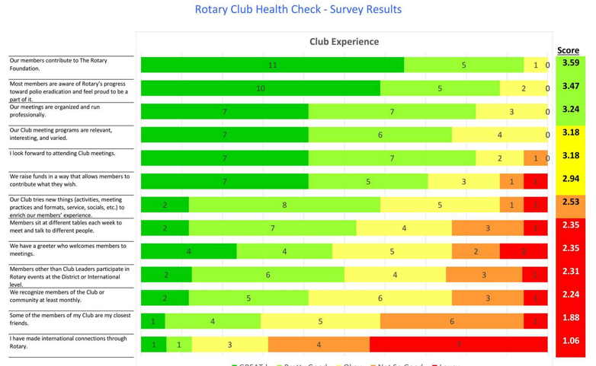

Slide 18
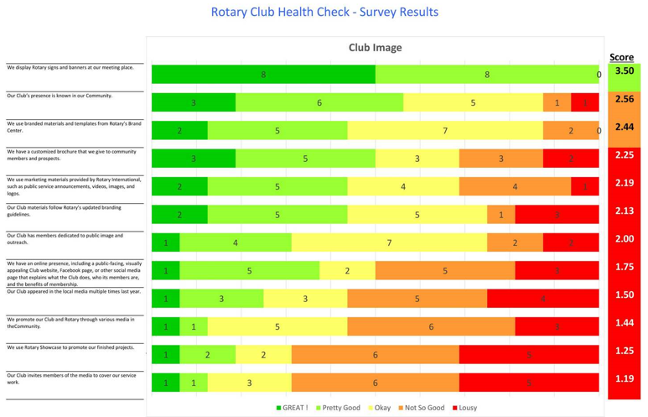
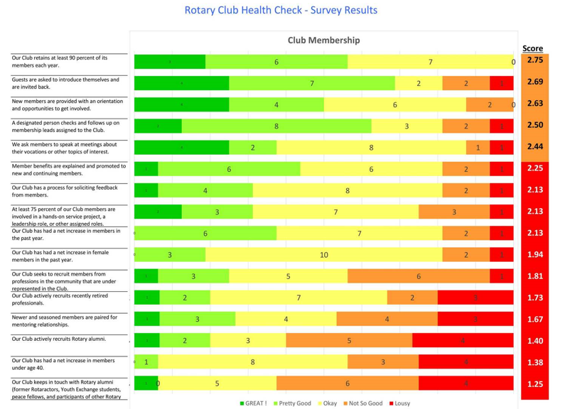
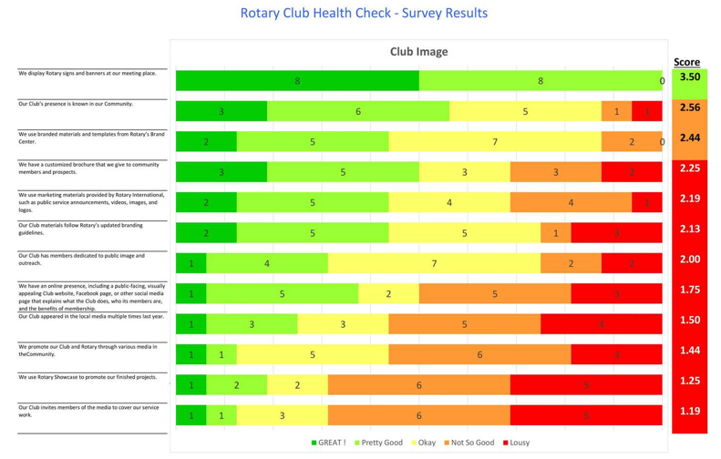

Slide 19

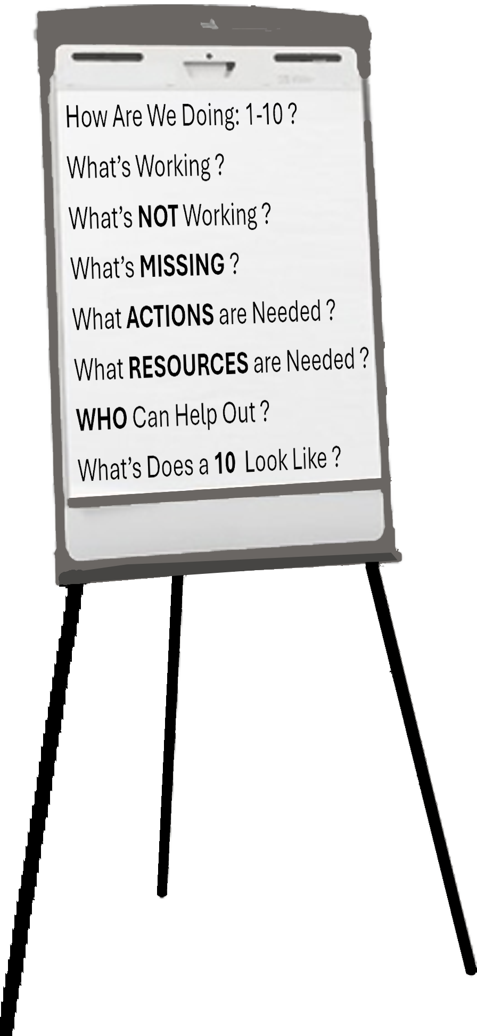
ROTARY CLUB ASSESSMENT
How is our Rotary Club doing on a Scale of 1-10 ?
What IS working?
What’s NOT working ?
What’s MISSING?
What ACTIONS are needed ?
What RESOURCES are needed?
WHO can help out ?
What does a 10 look like?

Slide 20

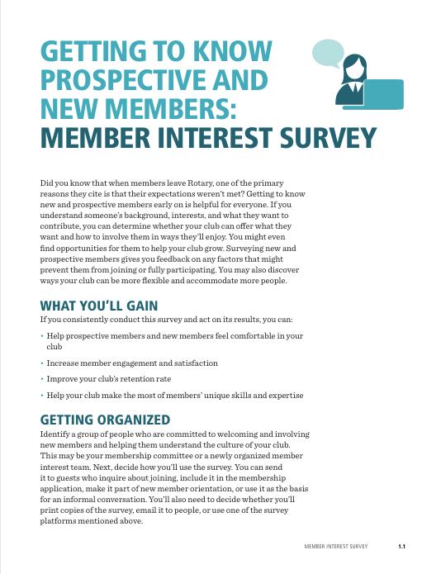
Rotary Tools…
Other Rotary Tools
No Longer Available (12 pages)
“Updated” Version” (7 pages)
Prospective & New Members
(7 Pages)

Slide 21
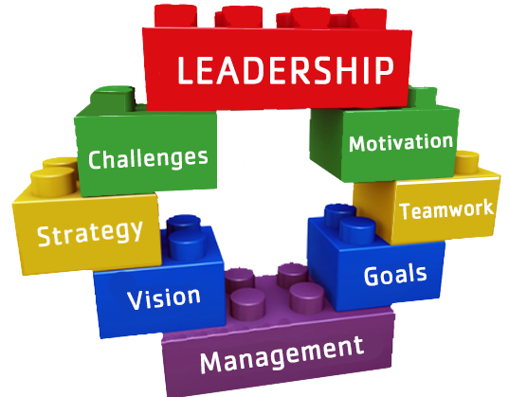
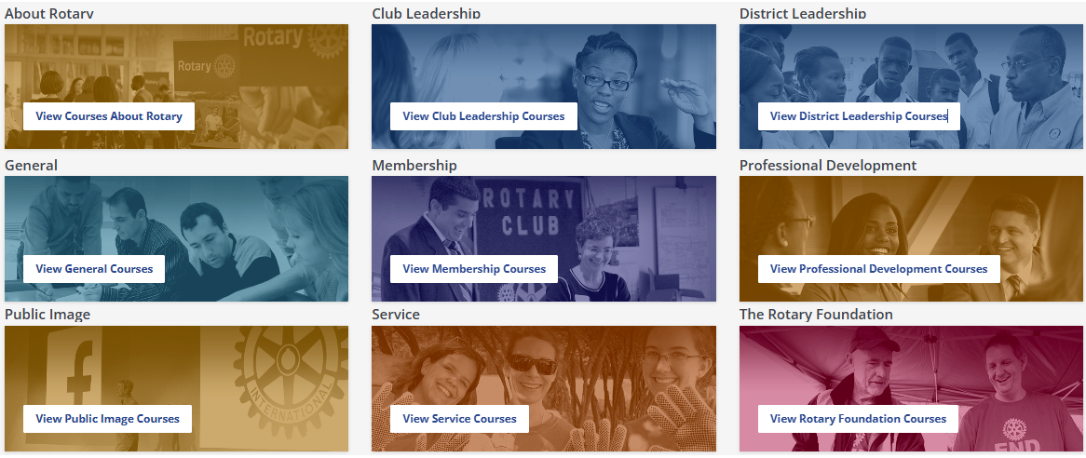

Other Resources…
Rotary Learning Center
Other Resources…
Excellent Membership Content Topics https://my.rotary.org/en/learning-reference/learn-topic/membership
Assess and Adapt
Engage Current Members
Connect with Prospective Members
Make NEW Members Feel Welcome
Create an Inclusive Club Culture
Strengthen your Club
Start a NEW club
Stay Current
Inclusive Club Culture
Strengthen Clubs
Start a NEW Club
Assessment and Adapt
Engage Members
Prospective Members
NEW Members Welcome
About Rotary
Our Structure
Action Plan
Leadership
Our Partners
History
https://my.rotary.org/en/knowledge-and-resources/resources-and-reference
https://RotaryLeadershipInstitute.org

Slide 22
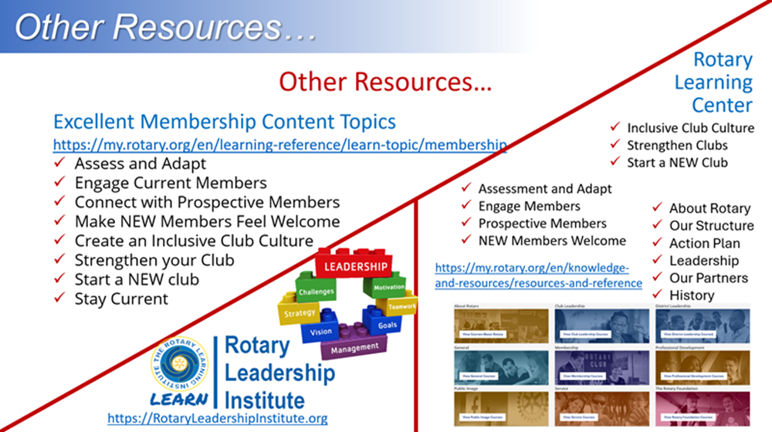
Questions ????????
Questions …? Comments …? Thoughts…?

Slide 23
THANKS !!!
Thanks for Listening !!!

