Slide 1

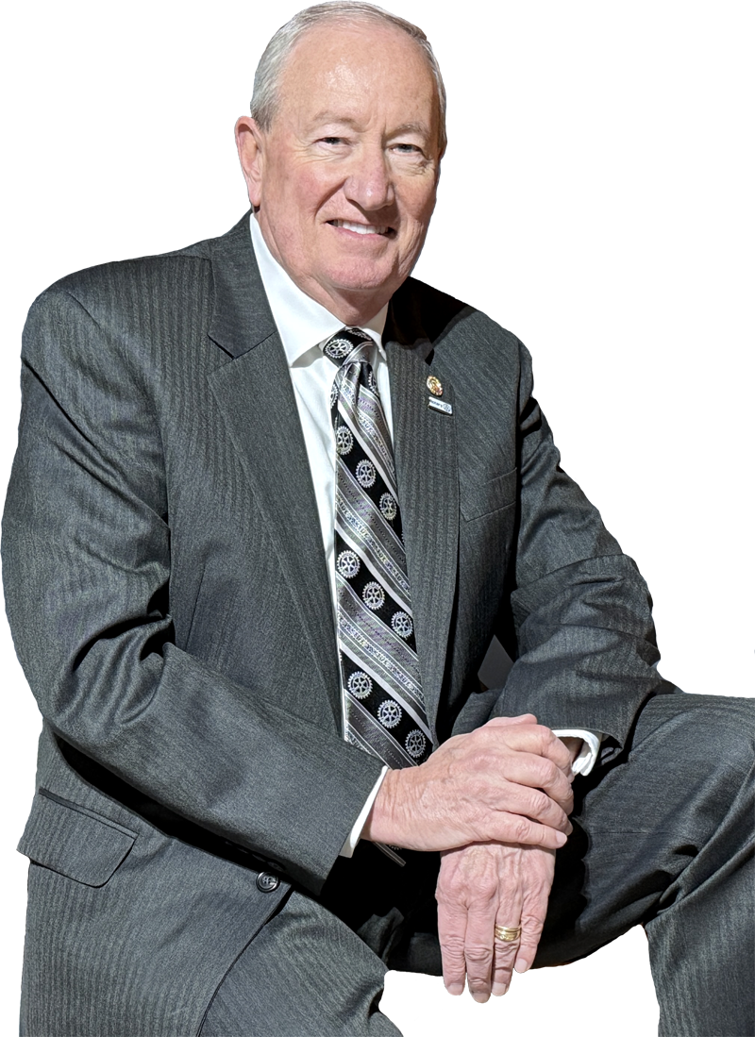

Welcome…
How GREAT Club Presidents
Lead and Manage
EXTRAORDINARY
Rotary Clubs and Rotarians
For Success In Their Communities !!!
`
Dave Haradon
Longwood Rotary Club
Kennett Square, PA
Past District 7450 Governor (2016-17)
Cell: 484-883-3110
Email: daveharadon@gmail.com
BE EXTRAORDINARY

Slide 2
Agenda
Todays’ Proposed Agenda
Rotary’s Vision & Mission
Our Mission as Rotarians
Managing People
TOP 10 ways to become an
EXTRAORDINARY Rotary Club !!!
Rotary Boot Camp
“Savoring” Rotary

Slide 3
Vision & Mission
Vision Statement
Describes an organization's long-term goals and aspirations.
Defines the organization's desired future image or legacy.
Looks forward ahead, longer term 3-5-10 years… and beyond !
Mission Statement
Defines the organization's PURPOSE !
Describes WHAT the organization does.
Says WHO the organization serves in the present.
Explains WHY the Organization Exists In The First Place

Slide 4
RI Vision…
Vision Statement
Rotary International
Our Vision is…
“TOGETHER, we see a world where people unite
and take ACTION to create lasting change
across our globe, in our communities
and in ourselves"

Slide 5
RI Mission…
Mission Statement
Rotary International
Our Mission is…
“to provide SERVICE to others, promote INTEGRITY
and advance world understanding, goodwill, and peace through our fellowship of business, professional, and community leaders.”

Slide 6

RI Mission…Integrity
Mission Statement
Rotary International
“to provide SERVICE to others, promote INTEGRITY
and advance world understanding, goodwill, and peace through our fellowship of business, professional, and community leaders.”

Slide 7

Integrity…

Slide 8


Integrity…
In Your Leadership
.
.
.
Do What You Say Your Going to Do !
Do It The Way You Say Your Going To Do It !!
Do It The Way That People Expect You Do It !!!

Slide 9
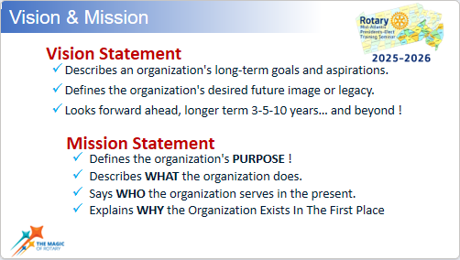


Your Own Club’s Vision…
Write Your Club’s Vision Statement
It's not just words on paper;
It's a vivid picture of your Club’s Future !
1. Reflect on Your Core Values: Think about the principles and values that matter most to your Rotary Club. What do you stand for as Rotarians
2. Define Your Purpose: What is the fundamental reason for your Club’s existence? What does your Club hope to achieve in the long run?
3. Imagine the Future: Envision the ideal future you want to create for your Club.
What does it look like? How does it feel? Who will it impact?
4. Keep It Concise: A powerful vision statement should be brief, ideally one to two sentences. It should also be memorable and easy to understand for all concerned.
5. Use Clear and Inspiring Language: Your Club’s words should evoke emotions and inspiration! Avoid jargon or acronyms or complex terms that non-Rotarians may
not understand.
6. Be Ambitious Yet Realistic: Aim high but stay grounded in reality. Your Club’s vision should be aspirational yet realistically attainable.
7. Involve Your Team: Collaborate with your Club Leadership to gather diverse perspectives and ensure EVERYONE is “aligned” TOGETHER !

Slide 10
Your Own Club’s Mission…
Write Your Club’s Mission Statement
It's not just words on paper;
It's a vivid picture of your Club’s Future !
1. Reflect on Your Core Values: Think about the principles and values that matter most to your Rotary Club. What do you stand for as Rotarians
2. Define Your Purpose: What is the fundamental reason for your Club’s existence? What does your Club hope to achieve in the long run?
3. Imagine the Future: Envision the ideal future you want to create for your Club.
What does it look like? How does it feel? Who will it impact?
4. Keep It Concise: A powerful vision statement should be brief, ideally one to two sentences. It should also be memorable and easy to understand for all concerned.
5. Use Clear and Inspiring Language: Your Club’s words should evoke emotions and inspiration! Avoid jargon or acronyms or complex terms that non-Rotarians may
not understand.
6. Be Ambitious Yet Realistic: Aim high but stay grounded in reality. Your Club’s vision should be aspirational yet realistically attainable.
7. Involve Your Team: Collaborate with your Club Leadership to gather diverse perspectives and ensure EVERYONE is “aligned” TOGETHER !

Slide 11

My Club’s Mission…
My Club’s Mission
To Make a PROFOUND Impact in the Lives of People in our Community by applying our motto of “Service Above Self”
via the “Four Way Test"

Slide 12
RI Motto
“Service Above Self”
Four Way Test
Is it the truth ?
Is it fair to all concerned ?
Will it build goodwill
and better friendships ?
Will it be beneficial to
all concerned ?

Slide 13
RI Motto
“Service Above Self”
FIVE
Four Way Test
Is it the truth ?
Is it fair to all concerned ?
Will it build goodwill
and better friendships ?
Will it be beneficial to
all concerned ?
5. Is it FUN ?

Slide 14
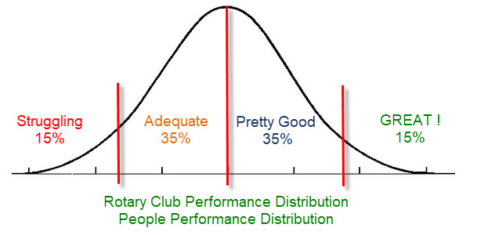
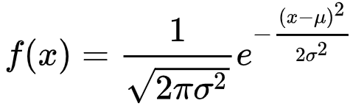
People
#1 Most Important Task for
GREAT Club Presidents
Leading and Managing PEOPLE
Average
“Normal” Distribution
Bell Shaped
Symmetry

Slide 15


People
#1 Most Important Task for
GREAT Club Presidents
Leading and Managing PEOPLE
Average
“Normal” Distribution
Bell Shaped
Symmetry

Slide 16

#1 Most Important Task for
GREAT Club Presidents
Average

Slide 17
#1 Most Important Task for
GREAT Club Presidents
Average

Slide 18
The Bell…

Slide 19


The Bell Curve…

Slide 20
The Bell Curve…
Struggling
(15%)
Adequate
35%
Pretty Good
(35%)
GREAT !
15%

Slide 21

The Bell Curve…
Struggling
(15%)
Adequate
35%
Pretty Good
(35%)
GREAT !
15%

Slide 22

The Bell Curve…
Struggling
(15%)
Adequate
35%
Pretty Good
(35%)
GREAT !
15%

Slide 23

The Bell Curve…
Struggling
(15%)
Adequate
35%
Pretty Good
(35%)
GREAT !
15%

Slide 24

The Bell Curve…
Struggling
(15%)
Adequate
35%
Pretty Good
(35%)
GREAT !
15%

Slide 25


The Bell Curve…
Struggling
(15%)
Adequate
35%
Pretty Good
(35%)
GREAT !
15%

Slide 26
The Bell Curve…
Struggling
(15%)
Adequate
35%
Pretty Good
(35%)
GREAT !
15%

Slide 27
Leading People…
Struggling
(15%)
Adequate
35%
Pretty Good
(35%)
GREAT !
15%
👍
🙌
👍
👍
👍

Slide 28

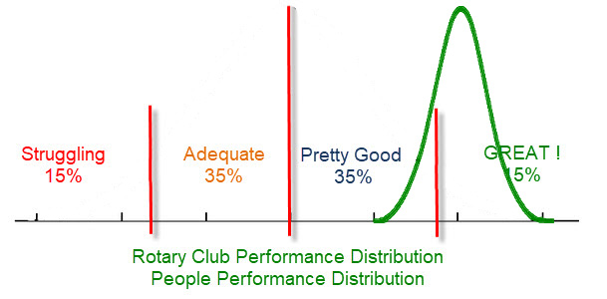
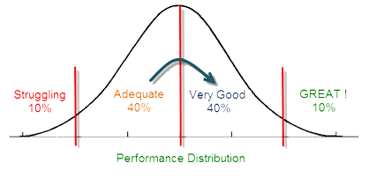


The Road to EXTRAORDINARY
Inspiration
Motivation
Encouragement
Opportunity
Normal

Slide 29


Normal vs. EXTRAORDINARY
Normal
(Average)
By Definition….
50% of People are “Below Average”
50% of Results are “Below Average”
50% of Rotary Clubs are “Below Average”
BEING NORMAL
BEING EXTRAORDINARY

Slide 30
Struggling
Adequate
Pretty Good
GREAT !

Slide 31
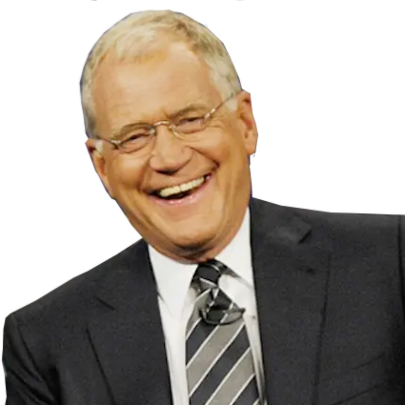
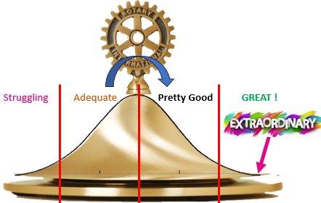
Dave’s Top 10 List…
David
Letterman
TOP 10 Ways a
Club President Can Create an
EXTRAORDINARY
Rotary Club
for Their Community !!!

Slide 32

Dave’s TOP 10 List
TOP 10 Ways a Club President Can Create
an EXTRAORDINARY Rotary Club
for Their Community !!!
Feedback and Improvement
Regularly seek feedback from both Club Members and the Community to IDENTIFY
AREAS FOR IMPROVEMENT.
Be open to change and continuously strive to ENHANCE YOUR CLUB'S IMPACT in the Community !

Slide 33

Dave’s TOP 10 List
TOP 10 Ways a Club President Can Create
an EXTRAORDINARY Rotary Club
for Their Community !!!
EXPAND: Grow Local and Global
Establish PARTNERSHIPS with other Rotary Clubs in other countries to work on international
projects TOGETHER.
.
This expands your Club's reach and IMPACT while fostering a sense of Global community BEYOND JUST YOUR SOLE ROTARY CLUB.

Slide 34

Dave’s TOP 10 List
TOP 10 Ways a Club President Can Create
an EXTRAORDINARY Rotary Club
for Their Community !!!
Diversify Your Fundraising
Organize a WIDE variety of fundraising events that appeal to different audiences.
.
Creative ideas like charity runs, auctions or virtual events KEEP THINGS FRESH.
GO BIG with larger events to have a
GREATER IMPACT in your Club’s Community.

Slide 35

Dave’s TOP 10 List
TOP 10 Ways a Club President Can Create
an EXTRAORDINARY Rotary Club
for Their Community !!!
Recognition and Award
CELEBRATE the achievements of your members and recognize their individual and collective contributions in our Rotary Club and with
other Rotary Clubs.
.
This will BOOST MORALE and encourage continued involvement, contributions and COLLABORATIONS TOGETHER !

Slide 36

Dave’s TOP 10 List
TOP 10 Ways a Club President Can Create
an EXTRAORDINARY Rotary Club
for Their Community !!!
Professional Development
Create, offer and encourage workshops, seminars, and networking events to HELP YOUR ROTARY CLUB MEMBERS grow professionally and personally.
.
Have new and old members attend ROTARY LEADERSHIP INSTITUTE (RLI) and Rotary International has marvelous online educational videos.
.
Create a culture that ADDS VALUE TO ROTARY MEMBERSHIP and promotes continuous learning

Slide 37

Dave’s TOP 10 List
TOP 10 Ways a Club President Can Create
an EXTRAORDINARY Rotary Club
for Their Community !!!
Create Strong Youth Programs
Install Rotary’s INTERACT AND ROTARACT program into the schools. Support RYLA and proactively recruit students. Involve youth in our Club’s activities and projects. Mentor them the meaning of “SERVICE ABOVE SELF” that will make a Lifelong Difference in their Lives. Create scholarships from your Club and teach them how to MAKE A DIFFERENCE.

Slide 38

Dave’s TOP 10 List
TOP 10 Ways a Club President Can Create
an EXTRAORDINARY Rotary Club
for Their Community !!!
Promote Your Club
Make PUBLIC RELATIONS an integral part of your communications success strategy, internally and externally. Use social media, local news outlets, and local events and community calendars to RAISE AWARENESS of your Rotary Club's initiatives. Share your Club’s success stories and highlight the POSITIVE IMPACT of your projects with EVERYONE !!!

Slide 39

Dave’s TOP 10 List
TOP 10 Ways a Club President Can Create
an EXTRAORDINARY Rotary Club
for Their Community !!!
Engaging and FUN Meetings
Keep meetings lively, engaging purposeful and FUN!
.
Include MISSION MOMENTS, informative guest speakers, interactive discussions, hands-on activities and IMPACTFUL project planning excitement.
.
Use TECHNOLOGY to keep members engaged, active and involved.

Slide 40

Dave’s TOP 10 List
TOP 10 Ways a Club President Can Create
an EXTRAORDINARY Rotary Club
for Their Community !!!
Create EXTRAORDINARY Members
Attract and retain normal people and develop them into EXTRAORDINARY Rotary members.
.
Encourage them to bring their unique skills and interests for the benefit of other people in your Community.
Offer them friendship, knowledge and explain the meaning behind our 4 Way Test. Share Rotary’s unique opportunities for personal growth within themselves and for their families.

Slide 41

Dave’s TOP 10 List
TOP 10 Ways a Club President Can Create
an EXTRAORDINARY Rotary Club
for Their Community !!!
Create EXTRAORDINARY Members
Attract and retain normal people and develop them into EXTRAORDINARY Rotary members.
.
ENCOURAGE THEM to bring their unique skills and interests
for the benefit of other people in your Community.
Offer them friendship, knowledge and explain to them the
MEANING BEHIND OUR 4 WAY TEST. Share Rotary’s unique opportunities for personal growth within themselves and their families.

Slide 42

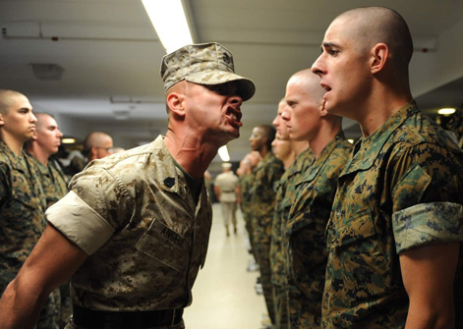
Rotary Boot Camp

Slide 43
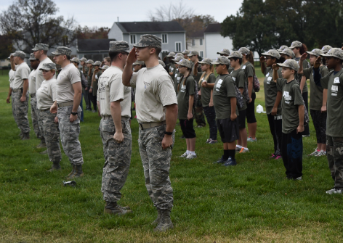
Rotary Boot Camp
EFFECTIVE AND INEFFECTIVE LEADERS
There are only two types of Club Presidents:
Effective and Ineffective !!!
.
EFFECTIVE Presidents lead successful
Rotary Clubs that accomplish what
they say they’re going to do.
.
Ineffective Presidents Don’t !

Slide 44
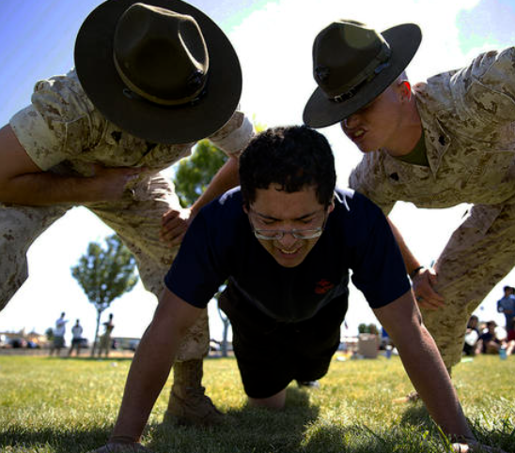
Rotary Boot Camp
YOU ARE TOTALLY RESPONSIBLE
All Club Presidents must keep in mind that YOU are entirely responsible.
YOU are responsible for FAILURE.
Your Club Member are responsible
for their SUCCESSES!

Slide 45
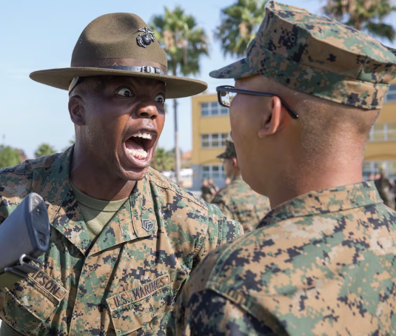
Rotary Boot Camp
YOU ARE TOTALLY RESPONSIBLE
All Club Presidents must keep in mind that YOU are entirely responsible.
YOU are responsible for FAILURE.
Your Club Member are responsible
for their SUCCESSES!

Slide 46
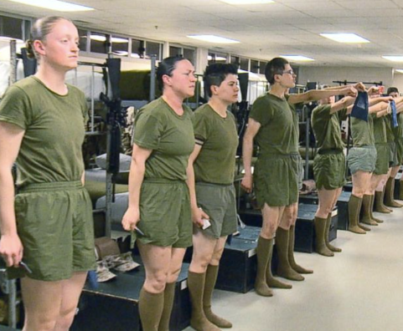
Rotary Boot Camp
OWN IT !!!
As a Club President…
YOU are 100% responsible,
no matter what happens.
.
YOU must ALWAYS OWN IT !

Slide 47
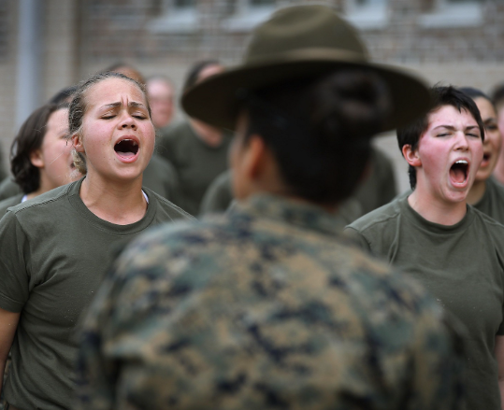
Rotary Boot Camp
BAD LEADERS CREATE BAD ROTARY CLUBS
BAD Clubs are created
by BAD Club Presidents.
.
GOOD Clubs are created by
GOOD Club Presidents.
.
EXTRAORDINARY Clubs are created
by GREAT Club Presidents !!!
.
Decide TODAY which YOU
are going to be !!!

Slide 48
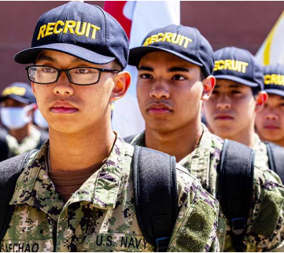
Rotary Boot Camp
BELIEVE IN WHAT YOU ARE DOING
Club Presidents believe in they are doing for their Club and for the people
in their Community.
.
If you don’t believe in it,
everyone will know it.
.
BE AUTHENTIC !!!

Slide 49
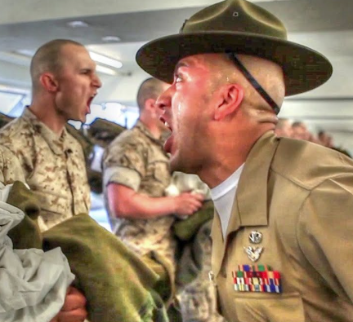
Rotary Boot Camp
PARK THAT EGO
Ego only gets in the way.
.
Keep things simple.
.
No drama.

Slide 50
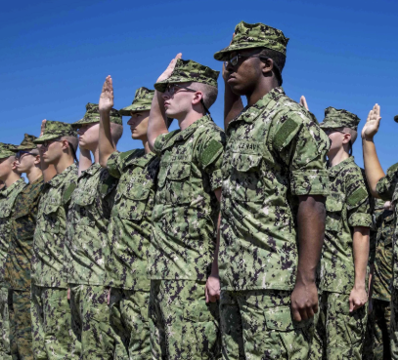
Rotary Boot Camp
BE COACHABLE
Listen to others and in turn
share your helpful coaching
with others as well.

Slide 51
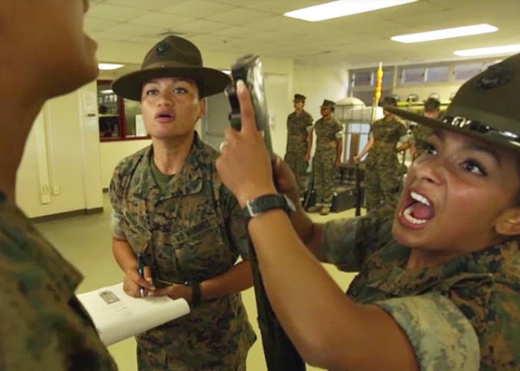
Rotary Boot Camp
ACCOUNTABILITY
Be Accountable for
YOUR own behavior.
.
Spread responsibility to junior leaders that YOU select.
.
Hold them and YOURSELF accountable to your Club’s Mission.

Slide 52
Rotary Boot Camp
PRIORITIZE AND DO IT
Prioritize what needs to be done.
.
Then get in ACTION and
DO IT…no excuses.

Slide 53
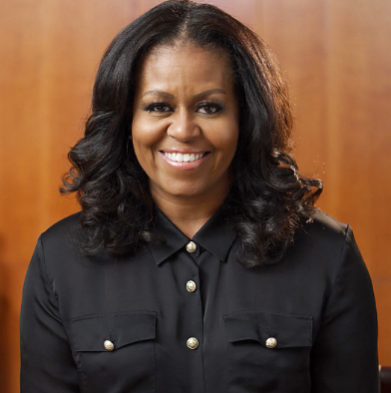
Michelle Obama – SHE’S GREAT
You Will Be Revealed
Quote from Michelle Obama…
.
“ You simply cannot fake your way through the job of being President.
.
It doesn't CHANGE who you are, but it sure does REVEAL who you are.”

Slide 54

Final Reflection…..
“Savor” Rotary
“The act of stepping outside of an experience to
review and appreciate what is present.”
.
.
Intensify and lengthen the positive emotions
that come from appreciating things we Love and Adore.

